Slide 1

Beginner friendly Introduction to build an R Package
Bocong Zhao
Twitter: @RLadiesMelb
Github: R-LadiesMelbourne

Slide 2
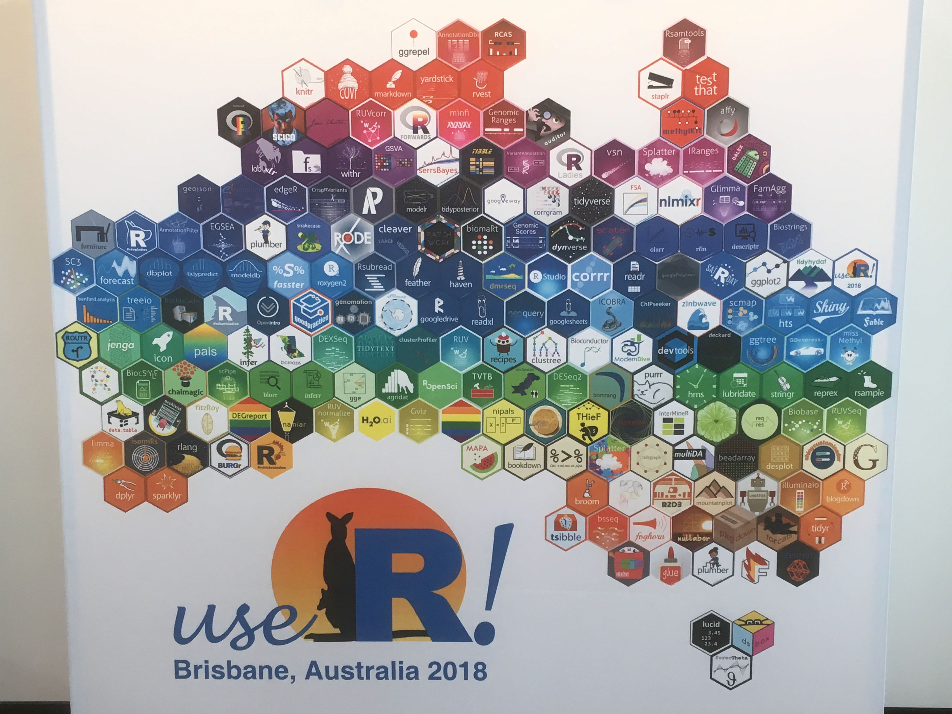
OUTLINE
A quick recap
R package components
Important functions
Common errors
Reference: https://pennydropper.netlify.app/2018/07/17/user-2018-conference-reflections/

Slide 3
A Quick recap

Slide 4
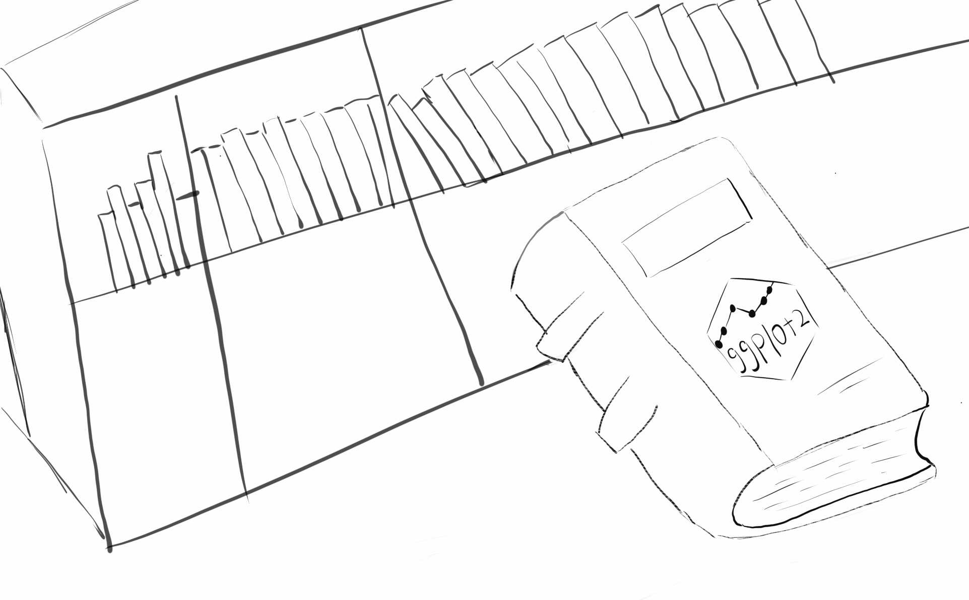
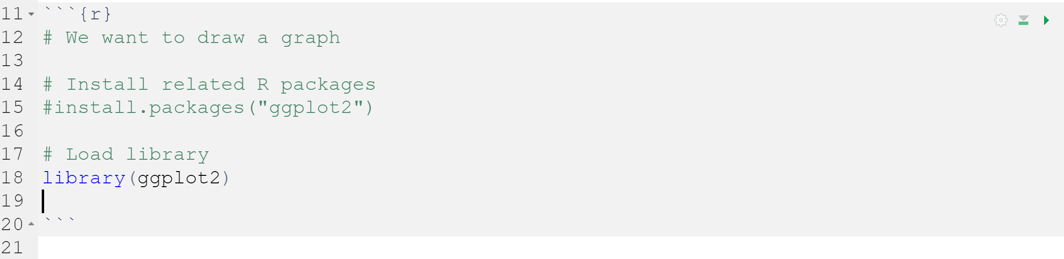
How to use ‘ggplot2’ to draw a graph in R? -- Load package!
In R, the package is the fundamental unit of shareable code

Slide 5
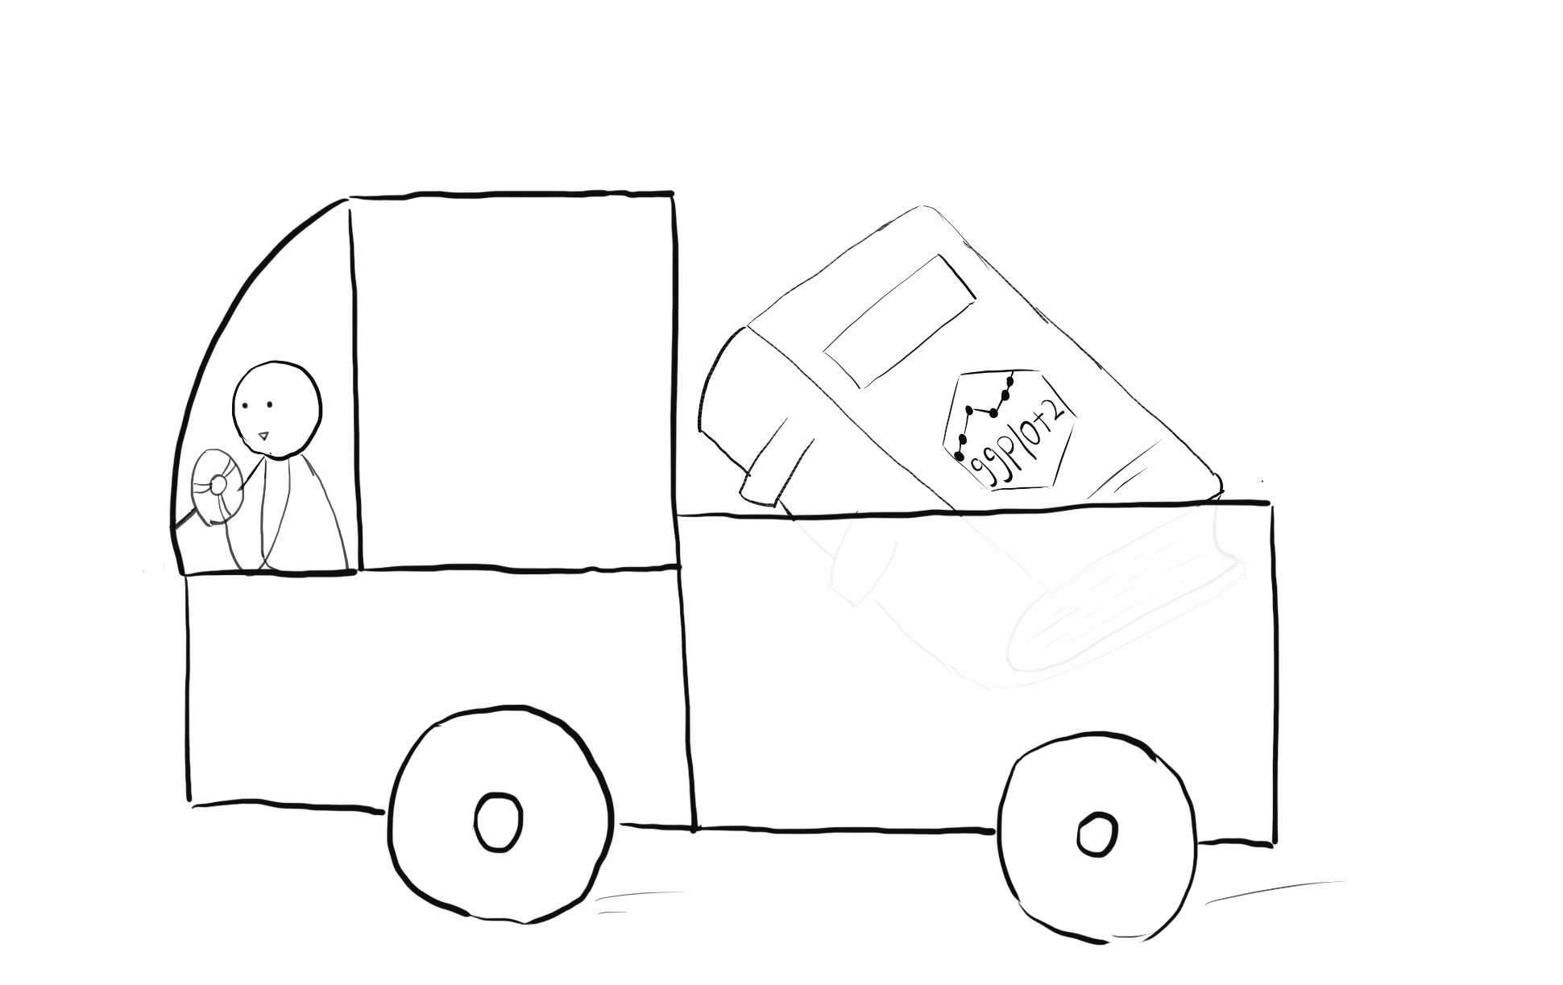
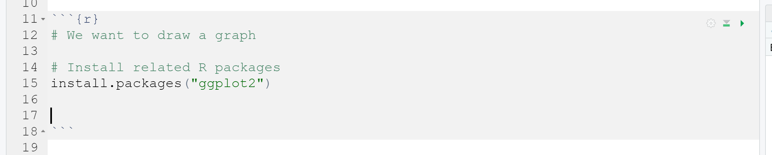
One step back…
How you be able to load “ggplot2” R Package? – Install Package!

Slide 6
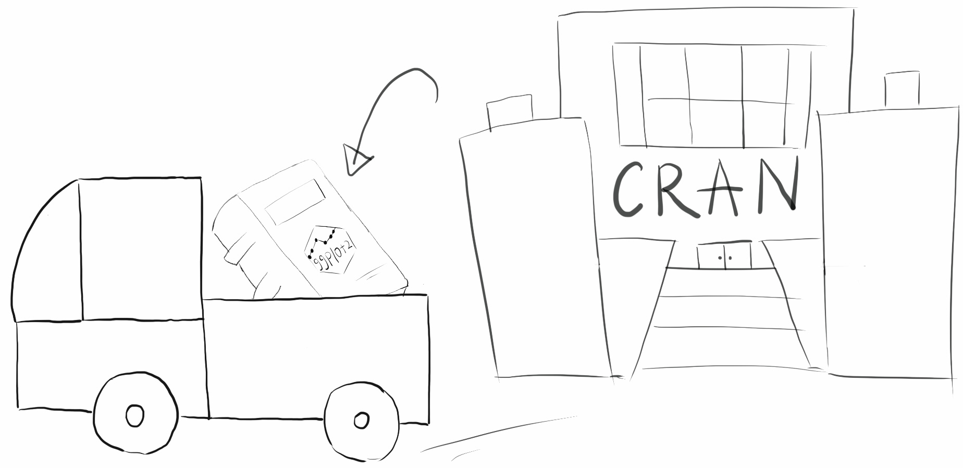
Where did you get the “ggplot2” R Package?– CRAN!
Packages available on the Comprehensive R Archive Network
CRAN is a public clearing house for R packages

Slide 7
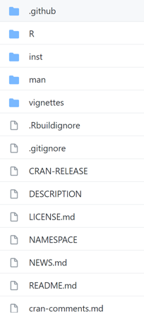
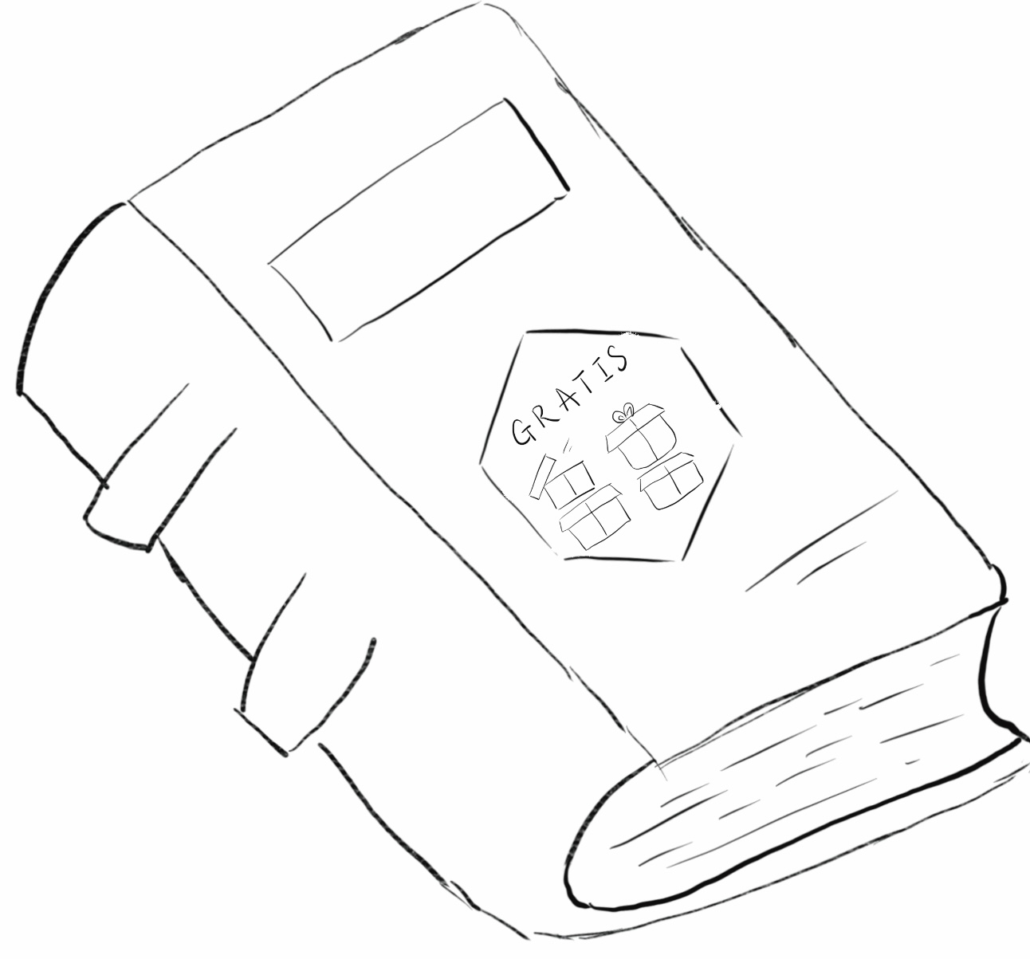
One more step back…
Where did R Package store before it available to CRAN? -- GitHub
If you want to learn further about GitHub, please refer to this link: https://guides.github.com/
Use R Package ‘gratis’ as an example in the following explanations
R package ‘gratis’ is done by Prof. Yanfei, Prof. Feng, Prof. Rob and Mitch. They are also very brilliant forecasters

Slide 8
So…
How did R Package be created?

Slide 9
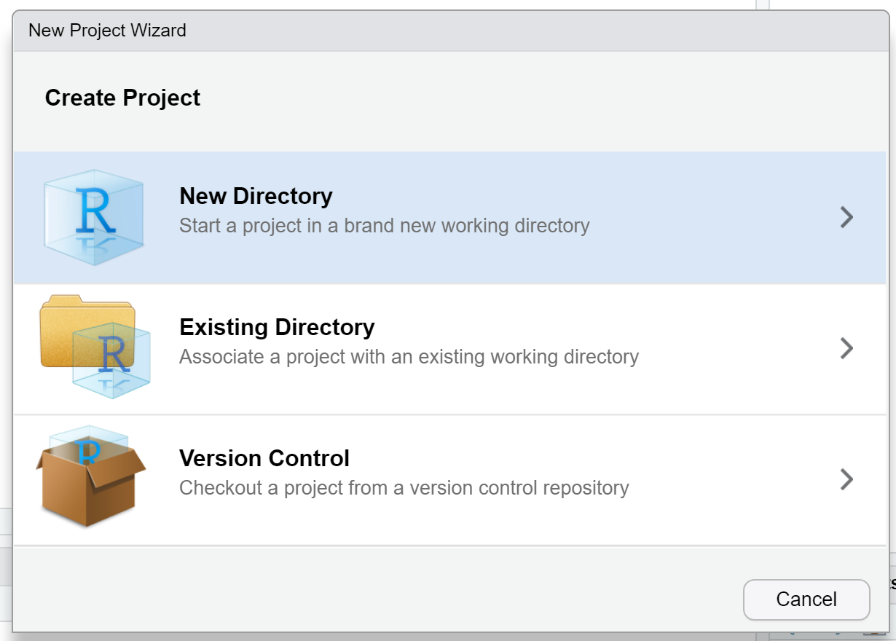
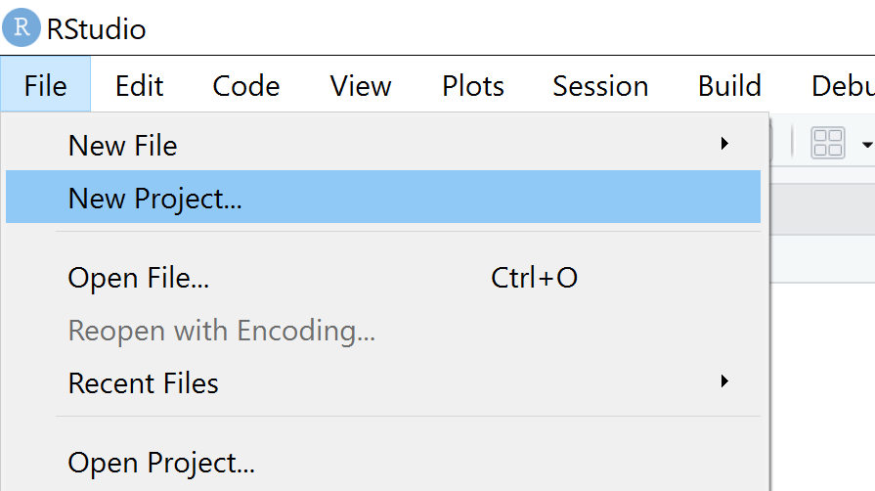
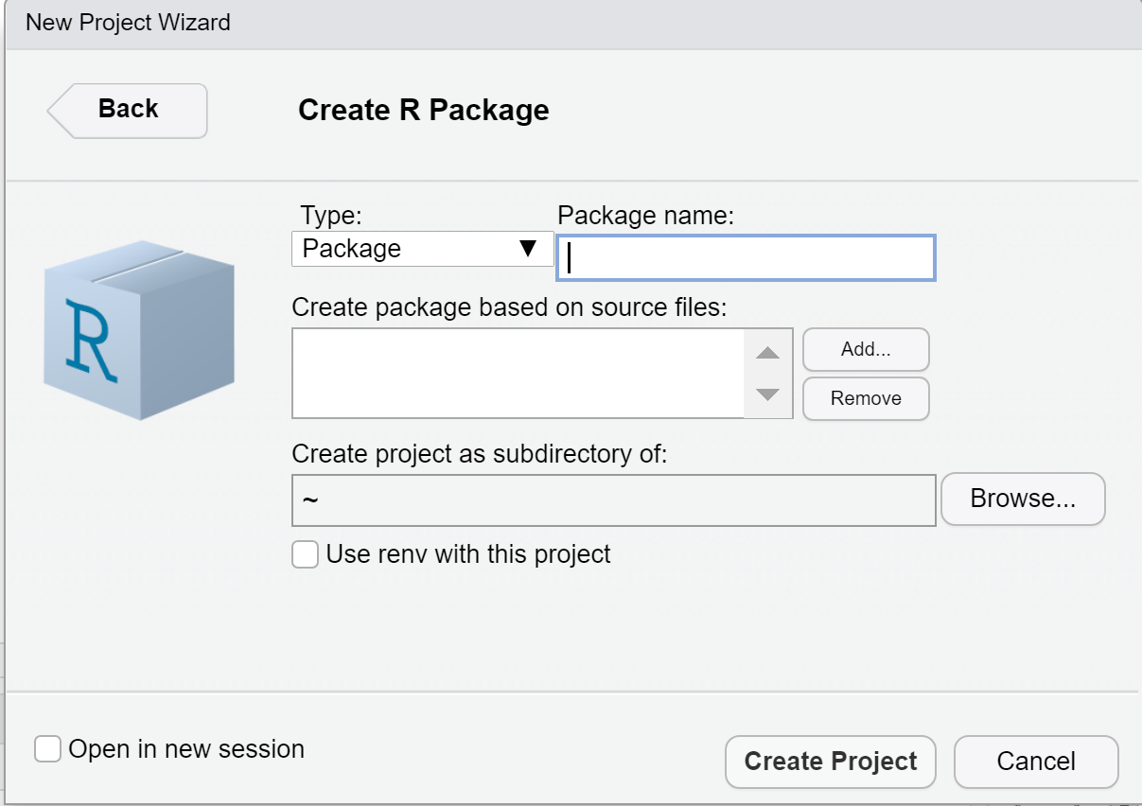
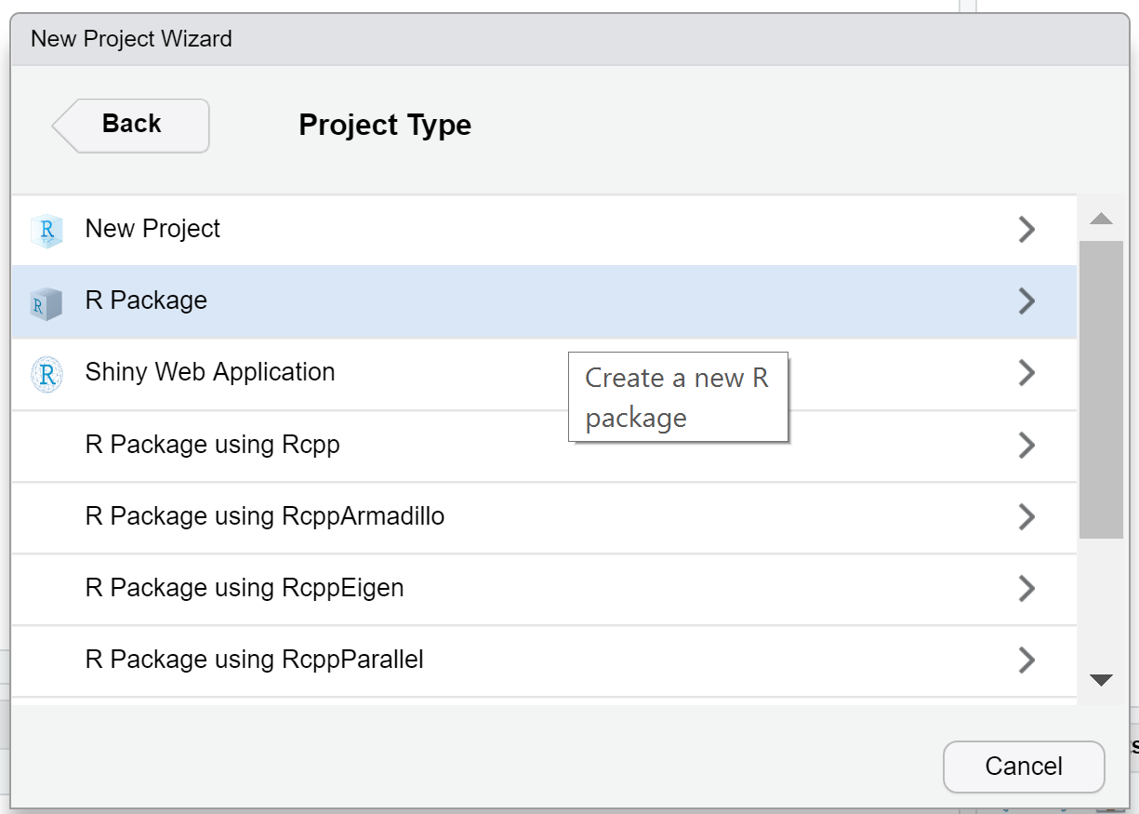
We can create an initial view of R package in RStudio
Method1: Write down usethis::create_package("path/to/your/package/folder/") in the R console
Method2: Follow the guidance of the screenshots

Slide 10
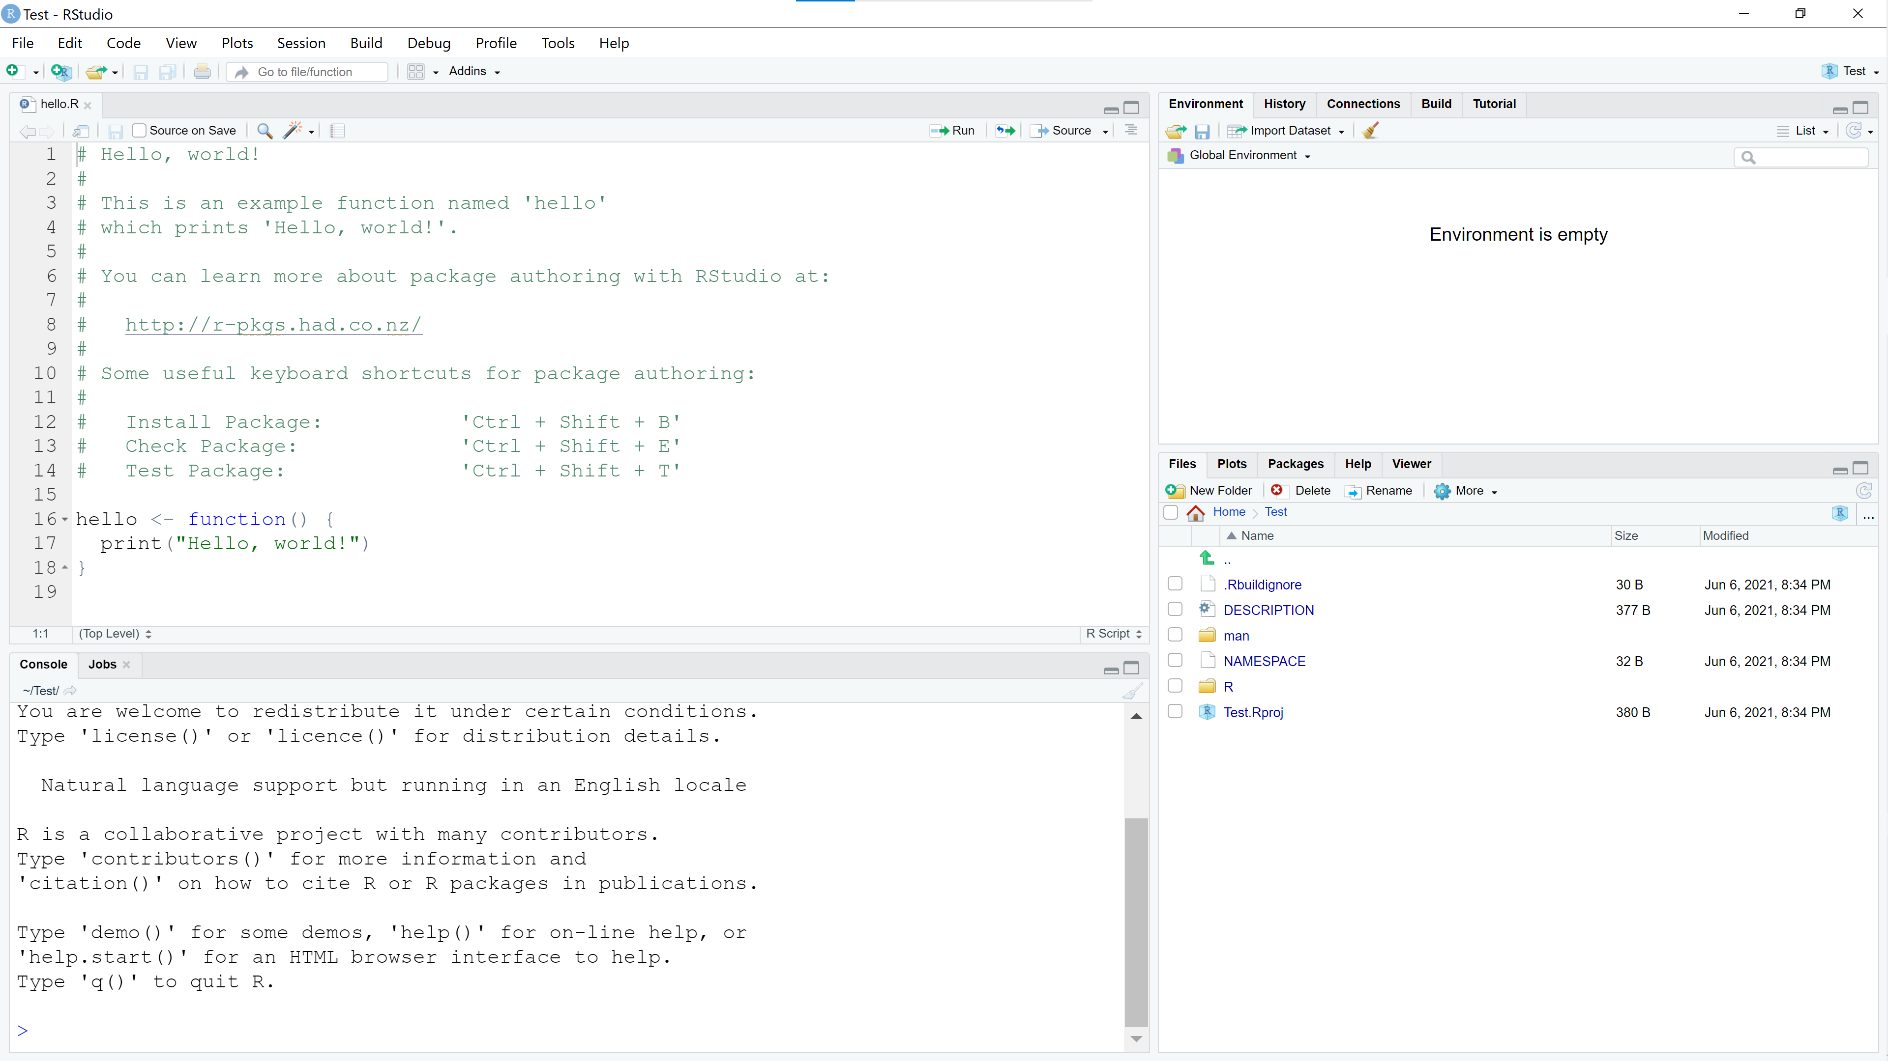

Slide 11
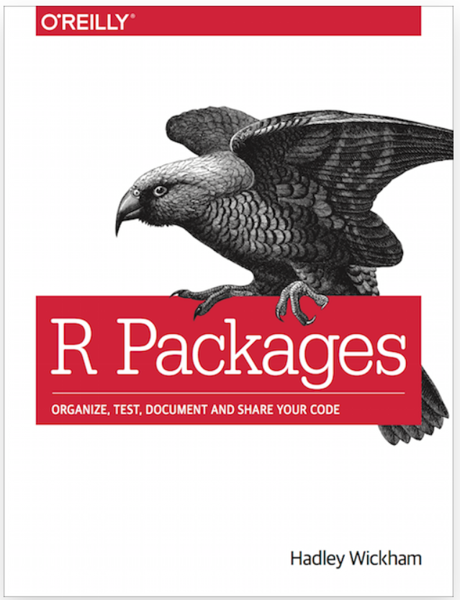
If you want to have a structured knowledge about how to build a R package, please do reading to this fantastic book written by Hadley Wickham and Jenny Bryan. It has a detailed explanation to guide you step by step.
Reference: https://r-pkgs.org/

Slide 12
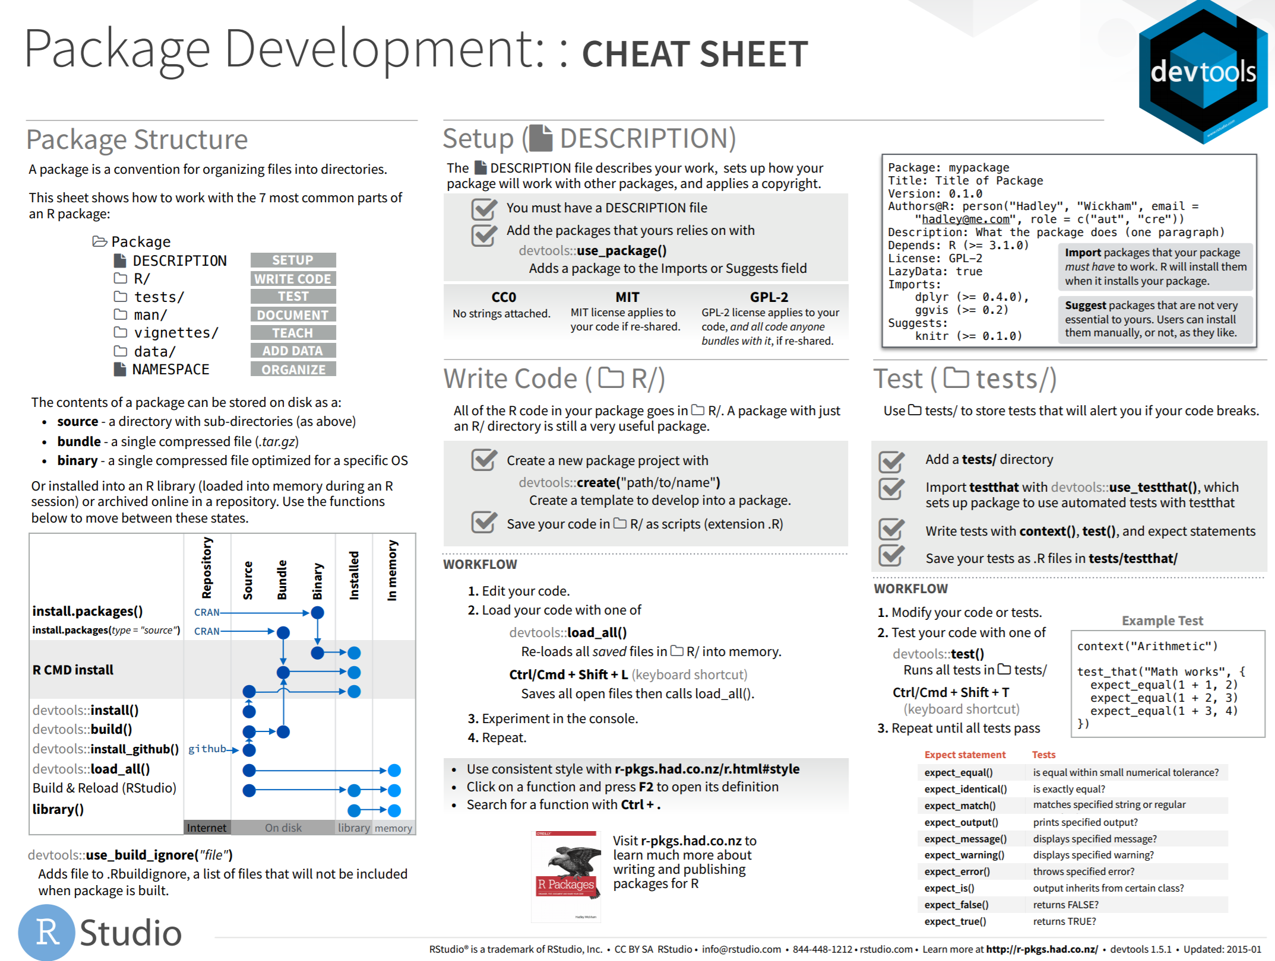
Package
Development Cheat Sheets
https://rawgit.com/rstudio/cheatsheets/master/package-development.pdf

Slide 13
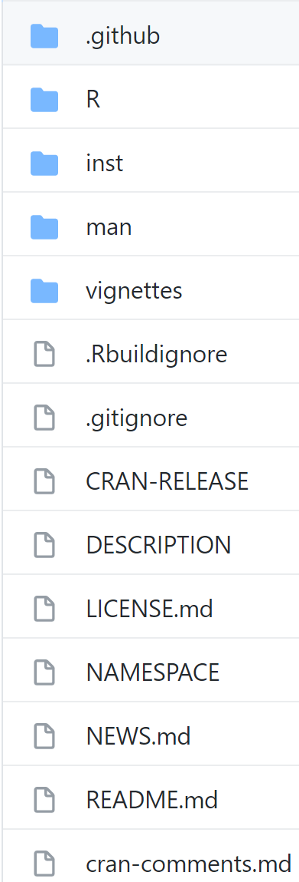
R Package components DESCRIPTION

Slide 14

DESCRIPTION/
DESCRIPTION/ contains Metadata
Metadata record
1) Dependencies
(What others’ packages are
needed to run our package)
2) License
(Who can use the package)
3) Package author
(Whom to contact)
Package: package_name
Title: What The Package Does
Version: 0.2.0
Authors@R: person("First", "Last", email =
"first.last@example.com",
role = c("aut", "cre"))
Description: What the package does (one paragraph)
Depends: R (>= 3.1.0)
License: What license is it under?
Imports: Require these packages to work
Suggests: Take advantage
LazyData: true
Reference: https://r-pkgs.org/description.html

Slide 15
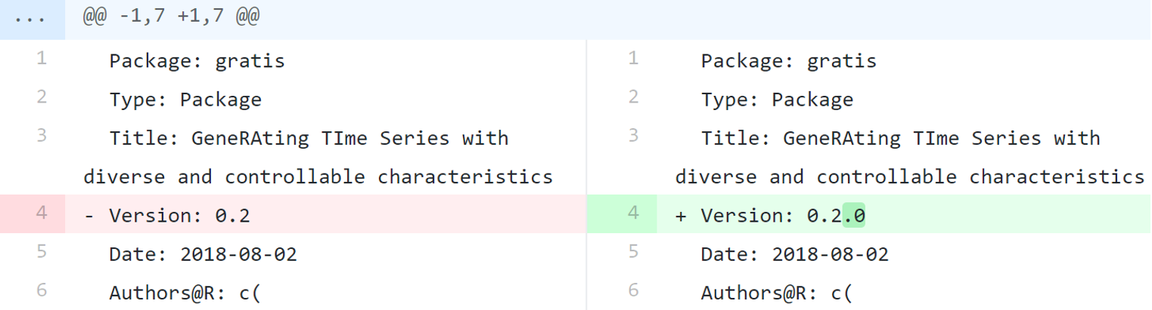
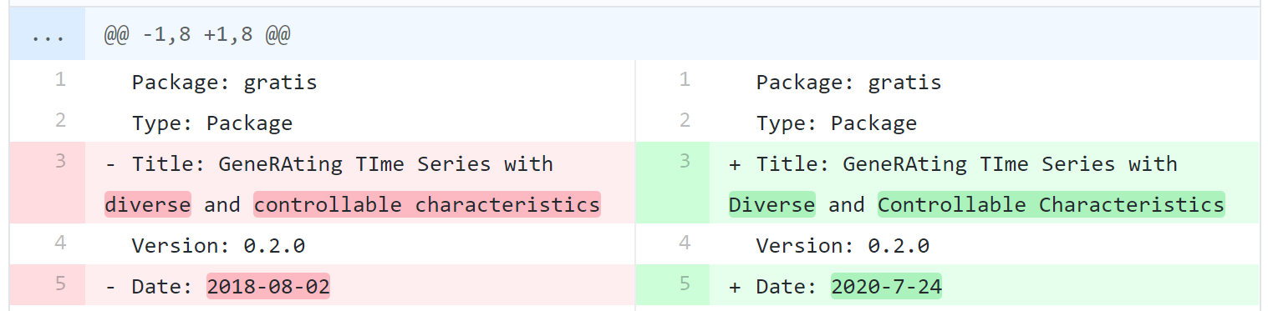
We should use a version number that has 3 integer components separated by .

Slide 16
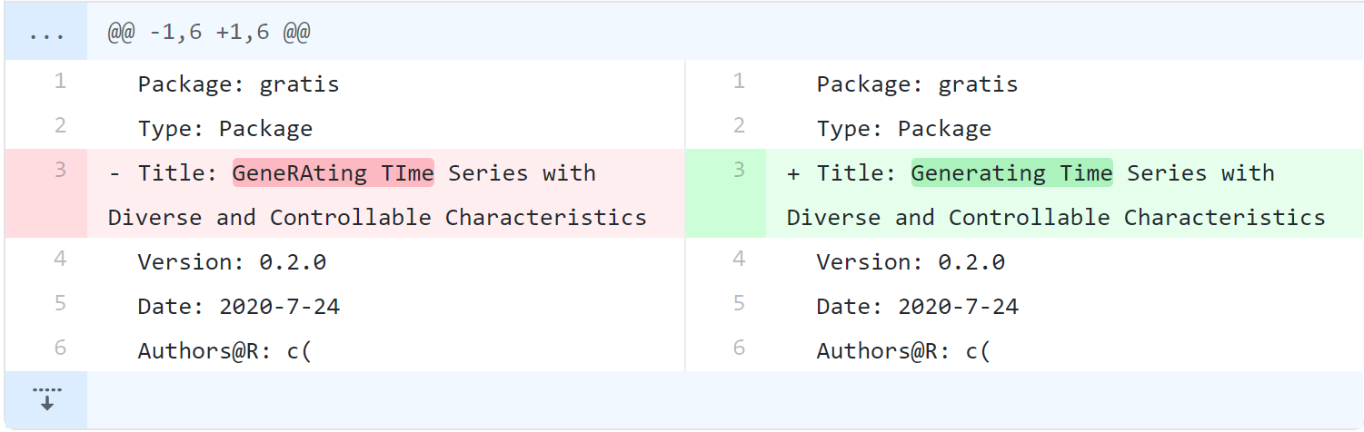
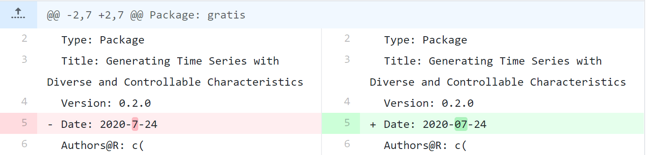

Slide 17
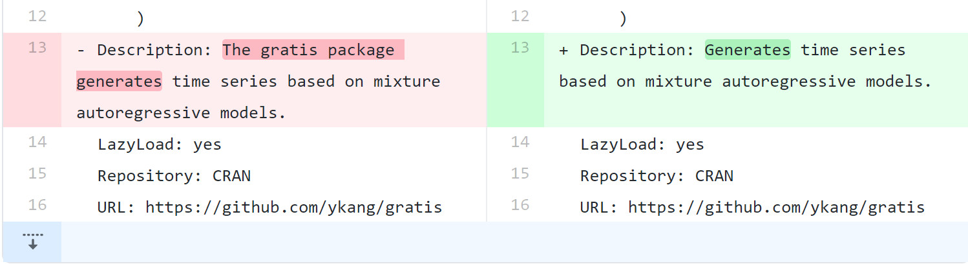
Do not start the description with “The package”, package name, title or similar

Slide 18
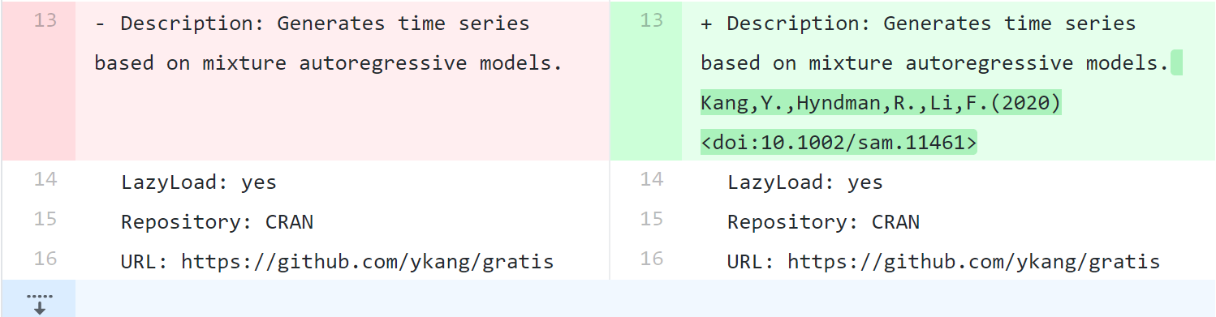
If there are references describing the methods in our package…
authors (year) <doi:…>
authors (year) <arXiv:…>
authors (year, ISBN:…)
Or if those are not available: <https:…>
With no space agter ‘doi:’, ‘arXiv:’, ‘https:’
Angle brackets for auto-linking

Slide 19
R Package components R

Slide 20
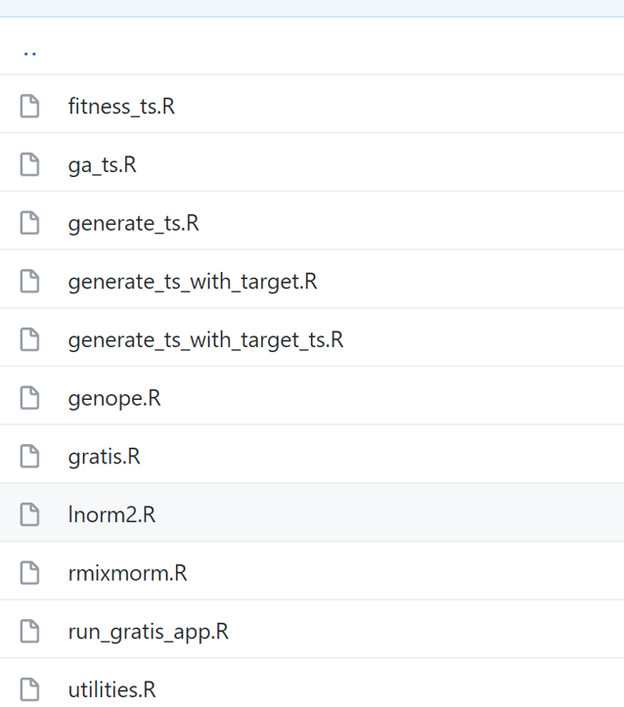

R/
All R code goes in the R/ directory
Store function definitions in R scripts (i.e. files with extension .R )
Don’t put all functions into one file & Don’t put each function into its own separate file
R/utils.R
Define small utilities that are used inside multiple package functions

Slide 21
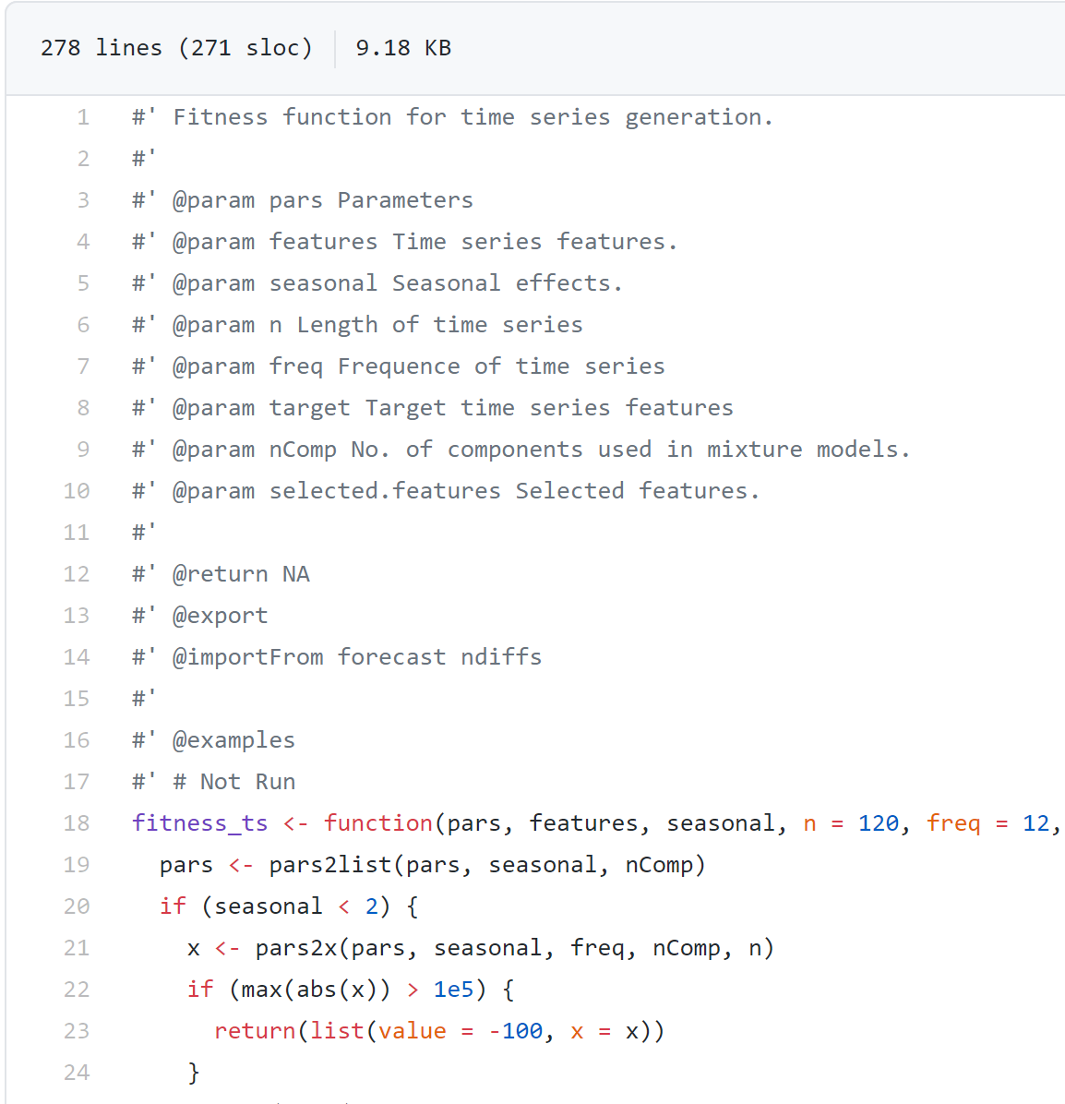
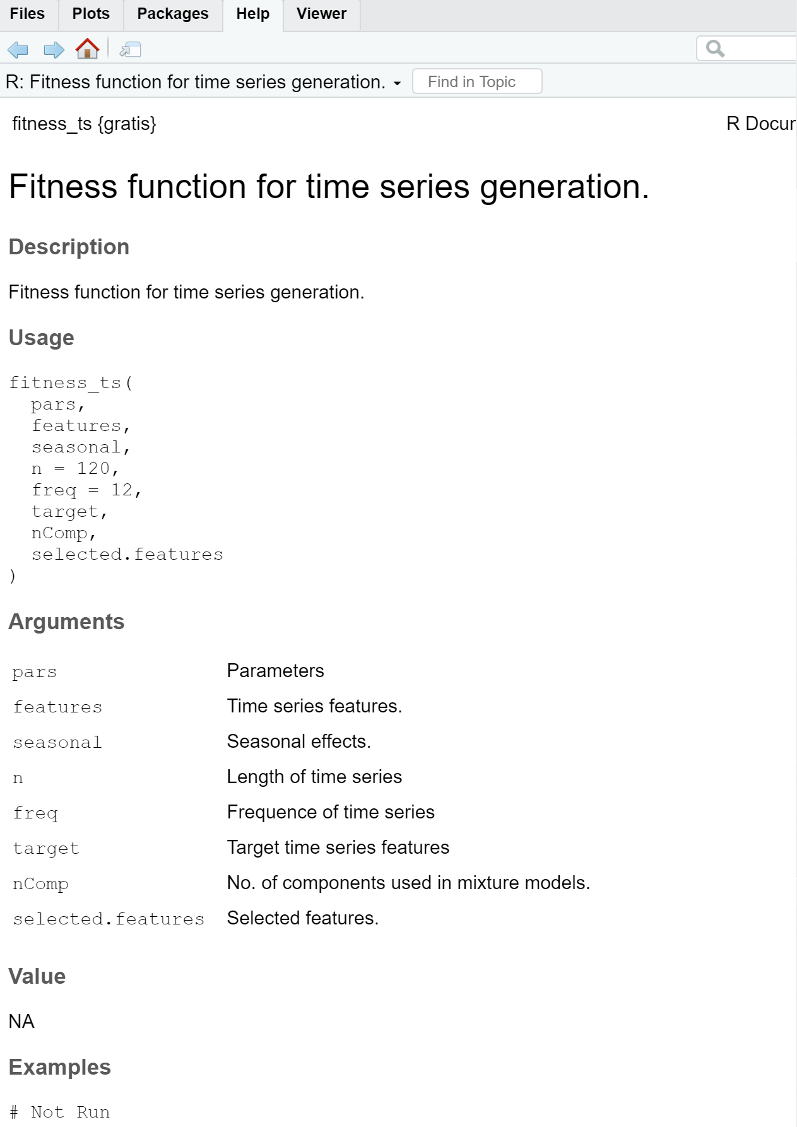
R/function_file.R ?? function_name

Slide 22
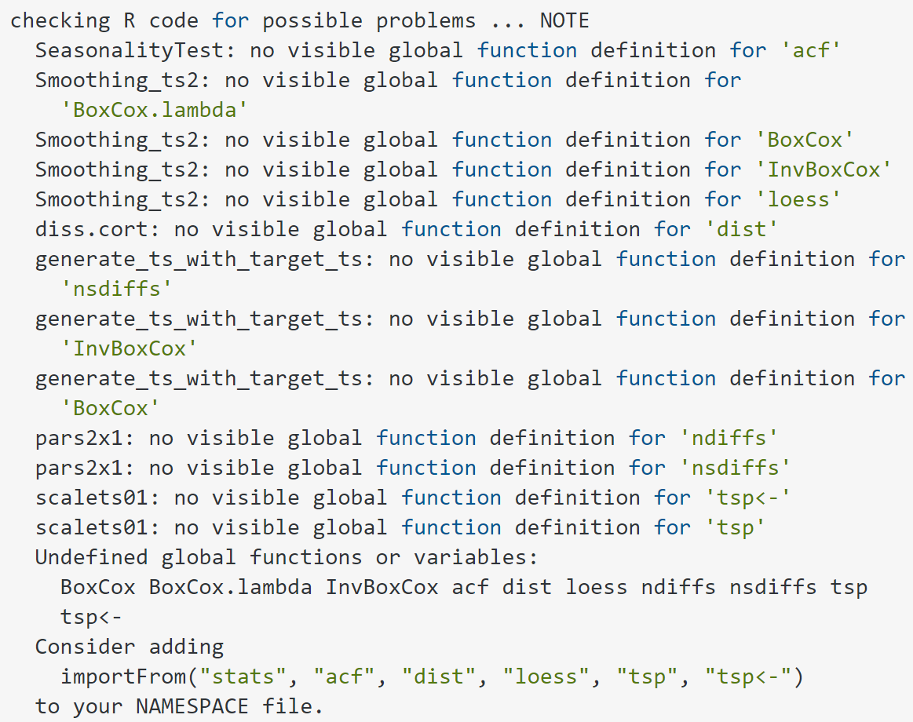
What would happen if we did not…
Specify the packages to import in each function definition using the @import or @importFrom
keywords in the Roxygen description

Slide 23
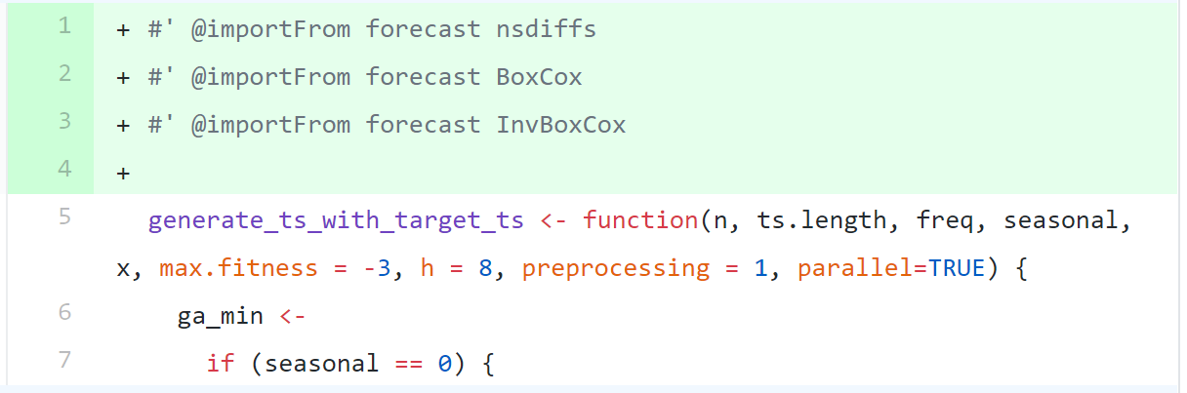
In order to avoide NOTE: “no visible global function definition for…”
Written down the code highlighted in green below
(Delete the old version NAMESPACE file)
Run devtools::document()
Then they would automatically shown in a new created NAMESPACE file
Reference: https://r-pkgs.org/namespace.html#imports

Slide 24
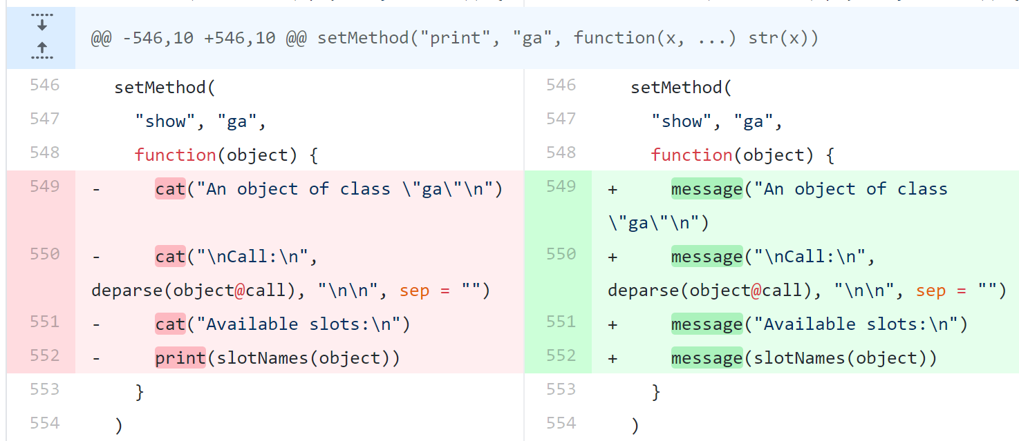
Do not write information messages to the console that cannot be easily suppressed.
Instead of print()/cat() rather
use message()/warning()
or if(verbose)cat(..)
or maybe stop()

Slide 25
R Package components Vignettes

Slide 26
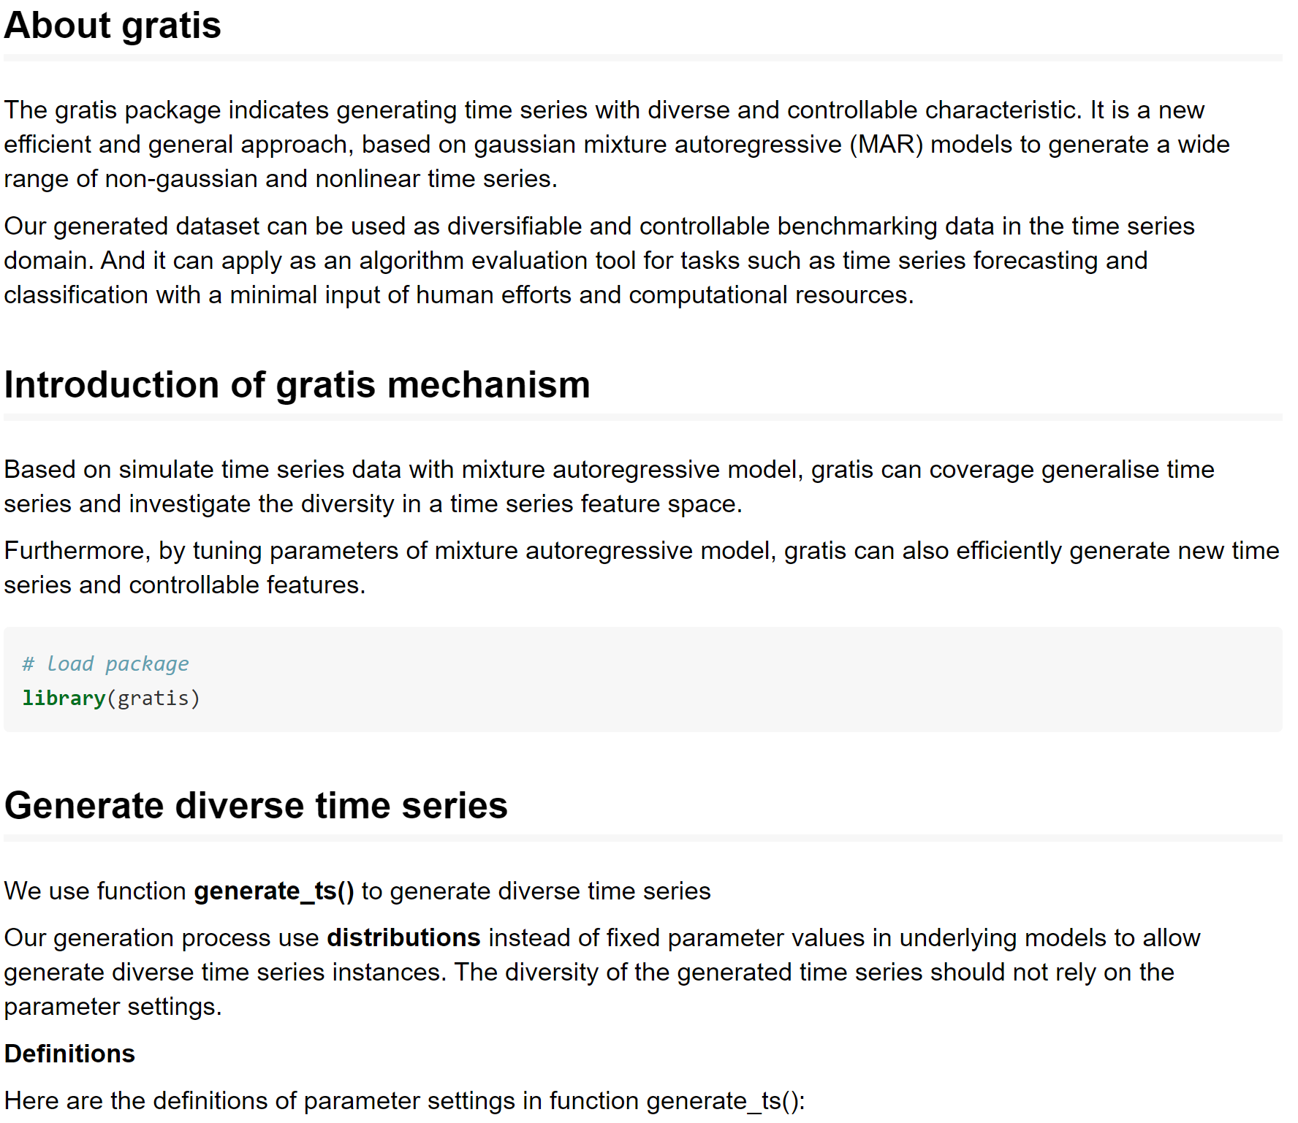
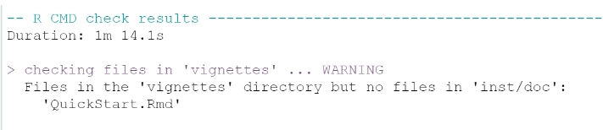
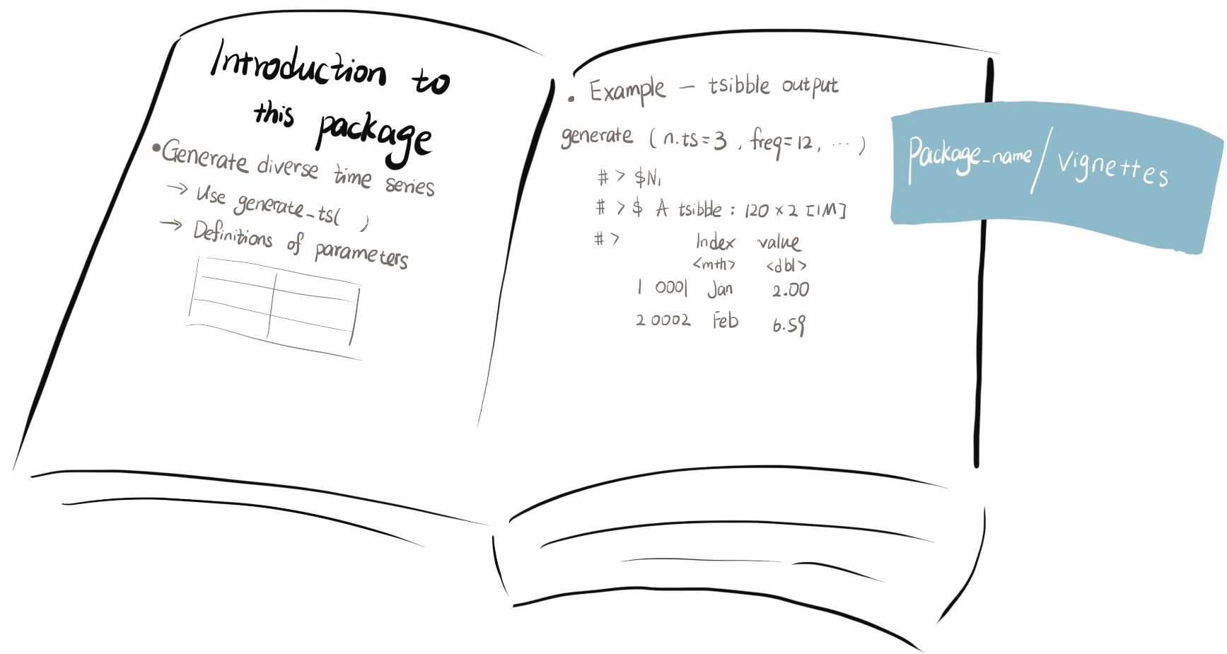
vignettes/
Vignette is an operating guidance for new users
To explain its principles, functions, and features
usethis::use_vignette(“my_vignette”)
Reference: https://cran.r-project.org/web/packages/gratis/vignettes/QuickStart.html

Slide 27
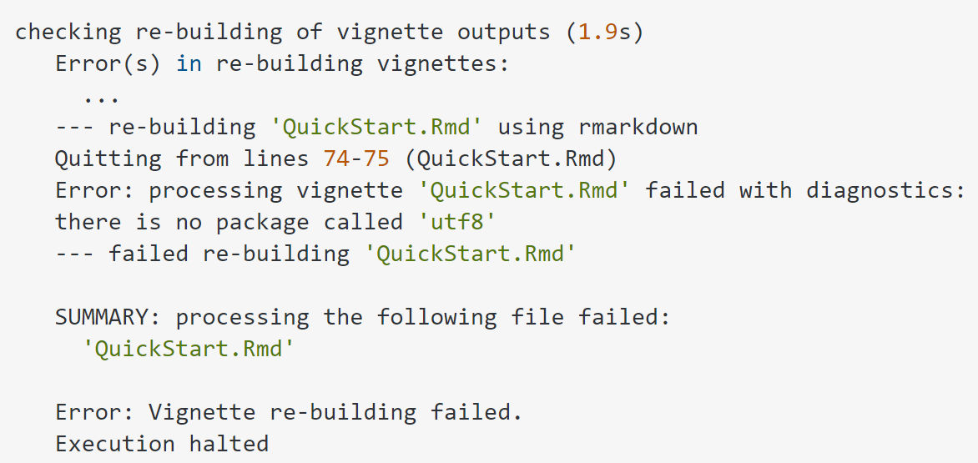
After doing, devtools::check_rhub()
The error said:
Runing this code would fix the issue
devtools::check_rhub(env_vars=c(R_COMPILE_AND_INSTALL_PACKAGES = "always"))
Reference: github.com/r-hub/rhub/issues/374

Slide 28
R Package components License

Slide 29
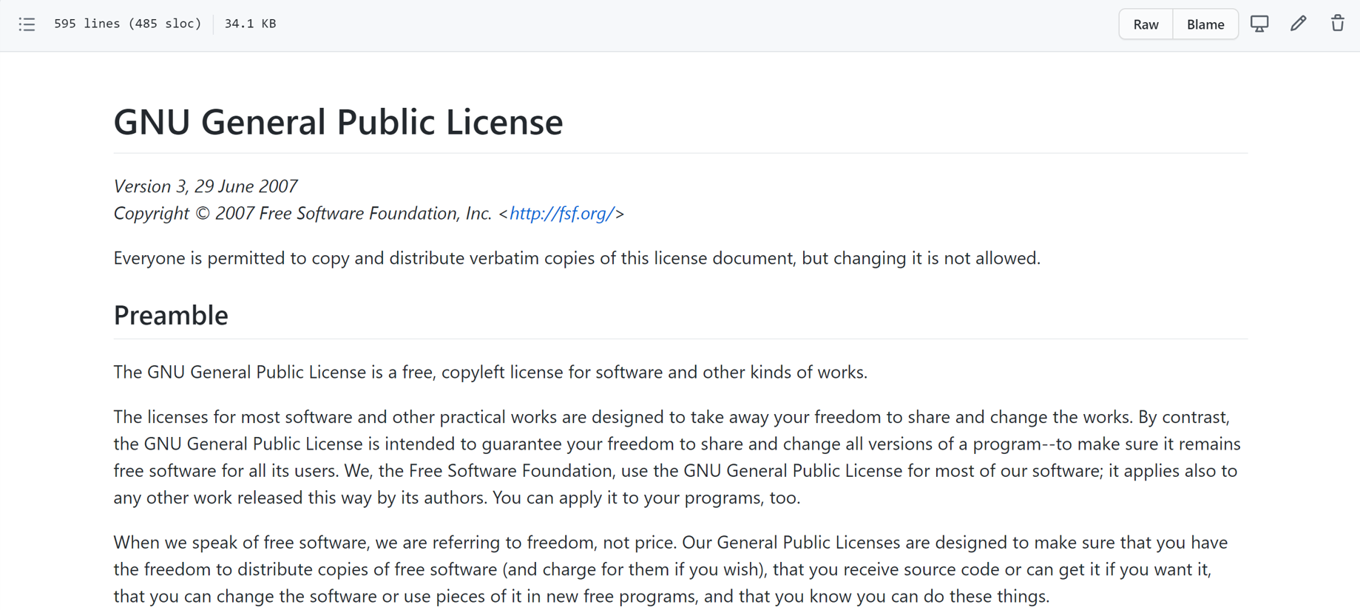
LICENSE/
GPLv3 license: a copyleft license – all derivatives & bundles of our code are also open source
usethis::use_gpl3_license(name = “author_name”)
Other types of license please refer to https://usethis.r-lib.org/reference/licenses.html

Slide 30
R Package components namespace

Slide 31
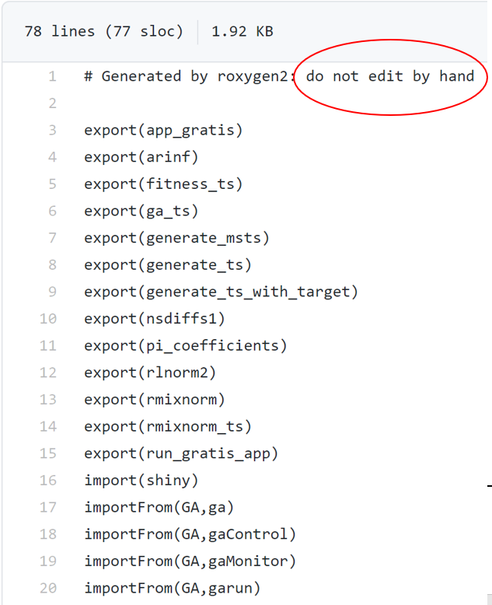
NAMESPACE/

Slide 32
R Package components inst

Slide 33
inst/CITATION
How to cite R and R packages.
Reference: https://github.com/RcppCore/Rcpp/blob/master/inst/CITATION

Slide 34
R Package components news

Slide 35
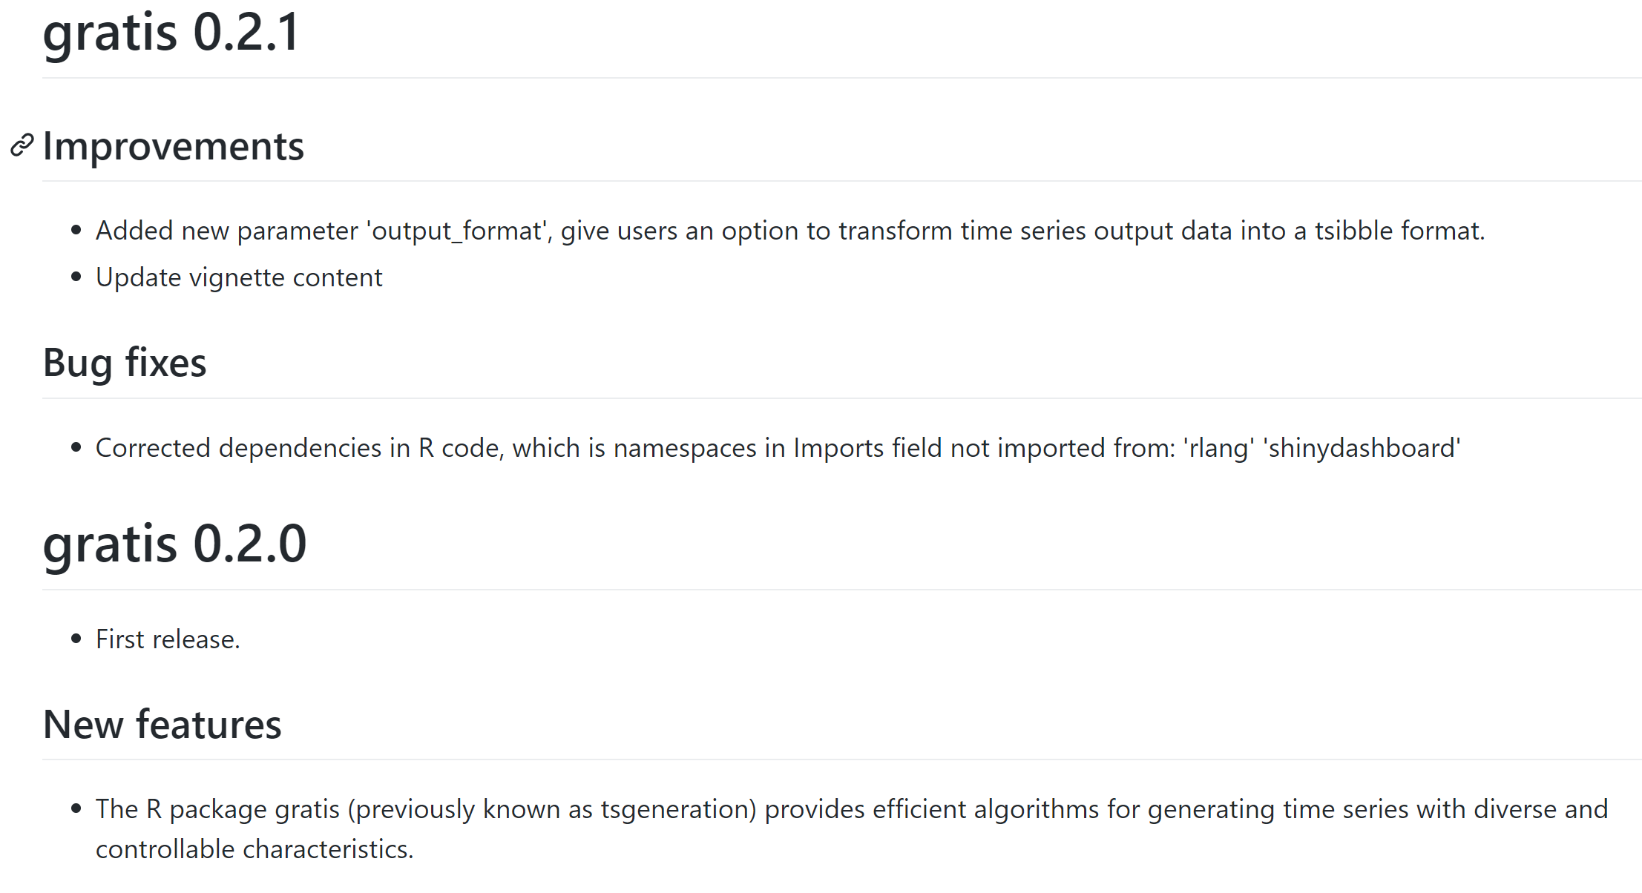
NEWS/
usethis::use_news_md()
Reference: https://usethis.r-lib.org/reference/use_news_md.html

Slide 36
Cran-comments

Slide 37
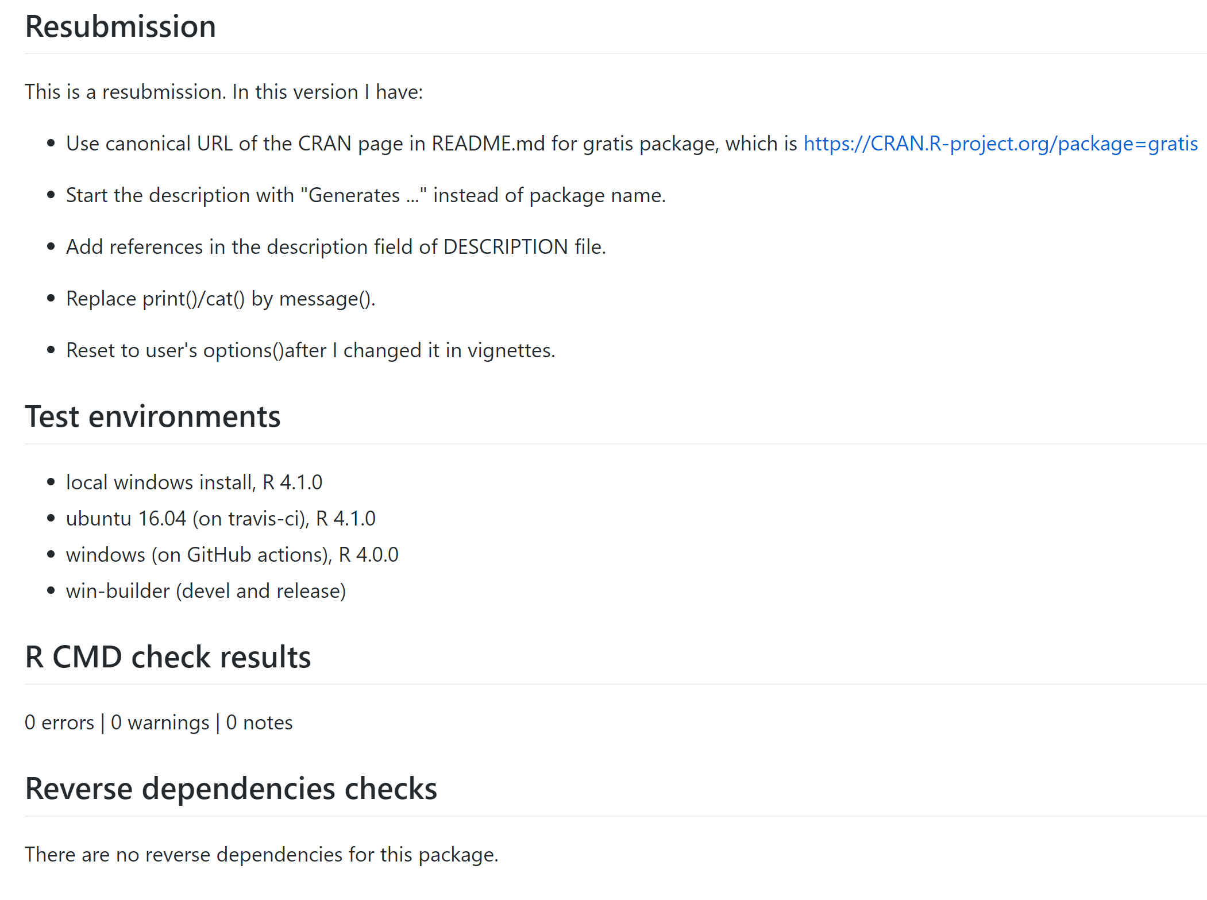
cran-comments/
A template for your communications
with CRAN when submitting a package
usethis::use_cran_comments()
Reference: https://usethis.r-lib.org/reference/use_cran_comments.html

Slide 38
Check

Slide 39
devtools::document()
devtools::check(carn=TRUE)
devtools::check_rhub()
devtools::release()

Slide 40
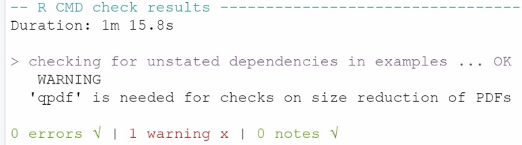
How to fix this problem?
https://stackoverflow.com/questions/41570633/how-to-build-qpdf-on-windows

Slide 41
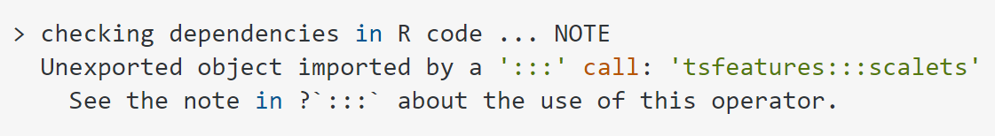
After doing devtools::check(cran=TRUE)…
We got this warning.
Why we cannot use ‘:::’?
How to fix this problem?

Slide 42
Release devtools::release()

Slide 43
devtools::release()
Q1: Have you checked for spelling errors (with `spell_check()`)?
1: Absolutely
2: No
3: I forget
Selection:
Enter an item from the menu, or 0 to exit
Selection: 1
Q3: Were devtool's checks successful?
1: Not yet
2: Uhhhh... Maybe?
3: Absolutely
Selection: 3
Q4: Have you checked on R-hub (with `check_rhub()`)?
1: I forget
2: Yup
3: Nope
Selection: 2
Q5: Have you checked on win-builder (with `check_win_devel()`)?
1: Yeah
2: No way
3: Nope
Selection: 1
Q6: Have you updated `NEWS.md` file?
1: I forget
2: Absolutely
3: Uhhhh... Maybe?
Selection: 2
Q2: Have you run `R CMD check` locally?
1: No way
2: No
3: Absolutely
Selection: 3
-- Running additional devtools checks for gratis ------------Checking version number has
three components... OK
Checking dependencies don't rely on dev versions... OK
Checking vignette titles are not placeholders... OK
Checking NEWS.md is not ignored... OK
Checking NEWS.Rd does not exist... OK
Checking DESCRIPTION doesn't have Remotes field... OK -------------------------------------------------------------

Slide 44
Q7: Have you updated `DESCRIPTION`?
1: No
2: Of course
3: Uhhhh... Maybe?
Selection: 2
Q8: Have you updated `cran-comments.md?`
1: No way
2: Uhhhh... Maybe?
3: Absolutely
Selection: 3
-- Running Git checks for gratis -----------------------------------------------
Current branch: master
Checking uncommitted files... OK ----------------------------------------------
Q9: Were Git checks successful?
1: Nope
2: Uhhhh... Maybe?
3: Yeah
Selection: 3
Q10: Is your email address …?
1: Uhhhh... Maybe?
2: Definitely
3: No
Selection: 2
Building
√ checking for file 'C:\Users\Documents\GitHub\gratis/DESCRIPTION' (1.7s)
- preparing 'gratis’:
√ checking DESCRIPTION meta-information ...
- installing the package to build vignettes
√ creating vignettes (15.1s)
- checking for LF line-endings in source and make files and shell scripts
- checking for empty or unneeded directories
- building 'gratis_0.2.0.tar.gz’
Submitting file: C:\Users\AppData\Local\Temp\RtmpCo3YwN/gratis_0.2.0.tar.gz
File size: 54.7 Kb

Slide 45
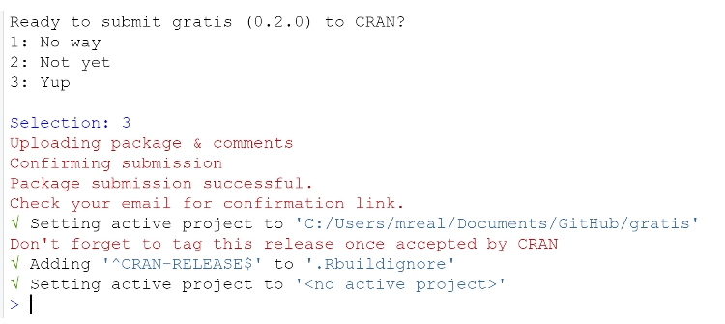
A live video about uploading R package on CRAN, please refers to Jim Hester’s YouTube Channel

Slide 46
We just saw the package release on CRAN today.
Package source: package_0.2.0.tar.gz which is available to download.
However, we notice that the
But we saw other’s package, here should be linked to a zip document.
What might cause this problem?

Slide 47
Thinking about when did we submit our package to CRAN.
It can take a couple of days for binaries to appear.
So luckily, there is nothing need to be fixed!

Slide 48
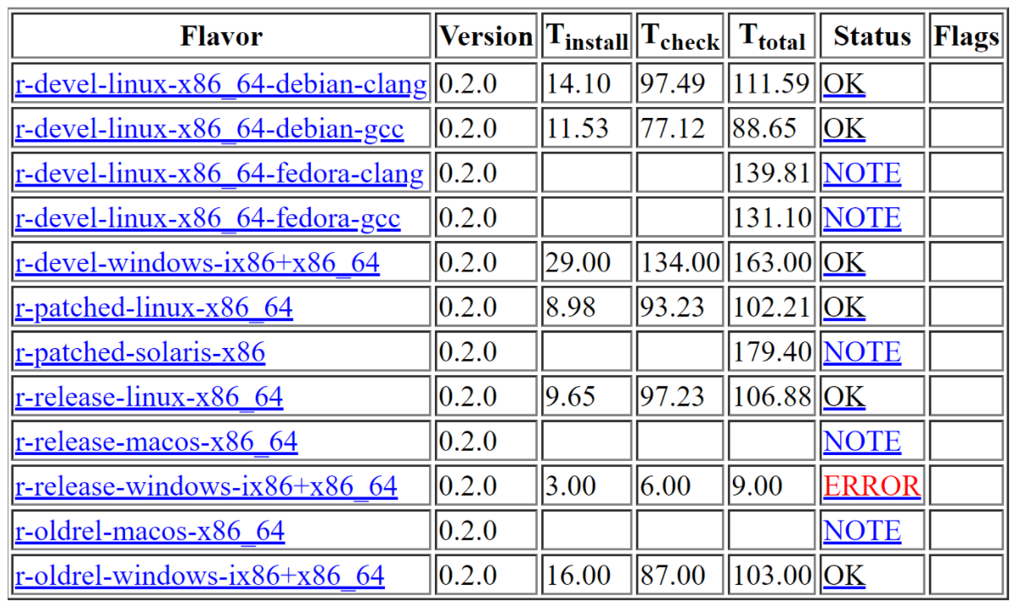
What might cause this problem?

Slide 49
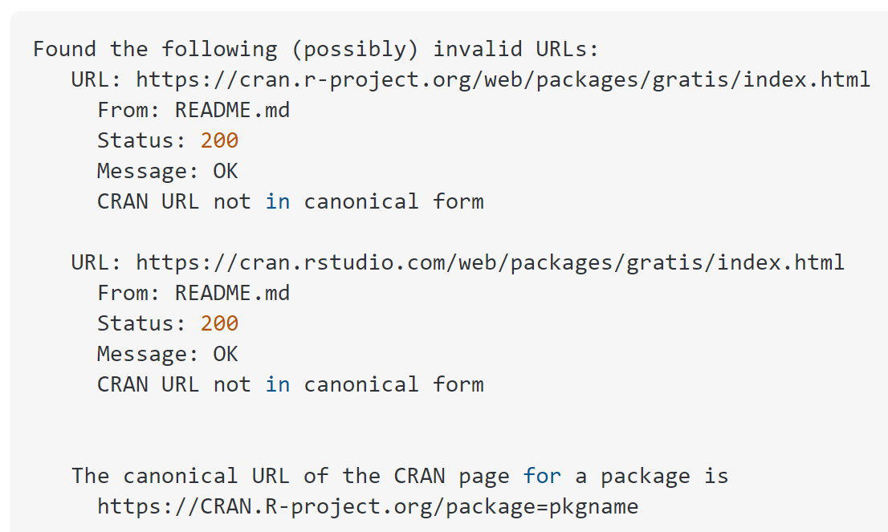
Now we tried to upload R package version 0.2.1
This time, CRAN reviewer gives us feedback that “CRAN URL not in canonical form”
The link ( cran.r-project.org/package=pkgname) is an example of how our link should look like.
For example ggplot would have have this
https://cran.r-project.org/package=ggplot2
Change into CRAN.R-project.org/package=gratis
And this change just happen in Readme.file”

Slide 50
R-CMD-check state usethis::use_github_action_check_standard()

Slide 51
To get badge automatically, open the R project with our package and run:
usethis::use_github_action_check_standard()
in the R console (or RStudio).
This will add a .github/workflows/ folder with some YAML content to our package
Reference: https://usethis.r-lib.org/reference/use_github_action.html

